Slide 1



{ Team No. 48 }
Problem Statement Title:
PS45: Statement: Quantum-Resistant Blockchain Security (Advanced)Description:Develop a blockchain framework that integrates post-quantum cryptographic techniques, suchas lattice-based and hash-based signatures, into consensus and transaction validation. Thesystem ensures resilience against quantum attacks while maintaining performance, scalability,and data integrity for decentralized finance, supply chains, and digital identity platforms.Additionally, it implements secure migration strategies for existing blockchain data andevaluates trade-offs between computational overhead and network efficiency to achievepractical, future-proof security.
Team Members:
Vedank Shinde
Shruti Dwivedi
Pradyumna Shingnapurkar
Shivani Bhosale
Teammate 4 Name
CBIT Hacktoberfest 2025
Notes:
3

Slide 2
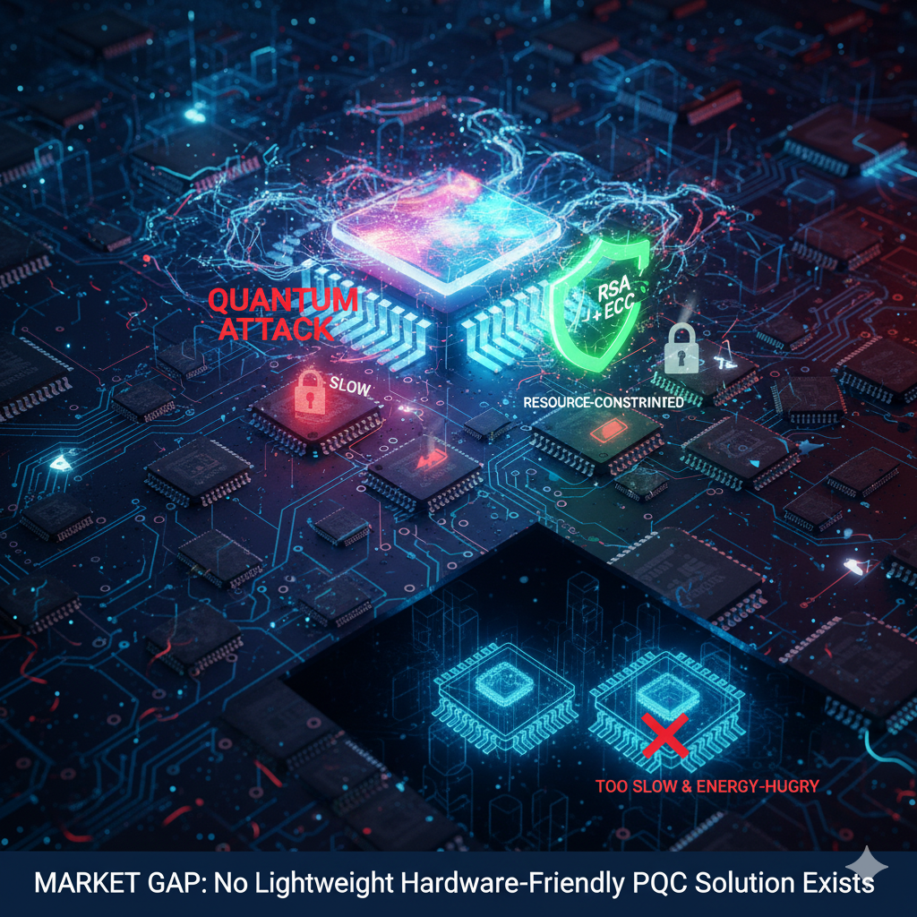
Team no.48
{ Proposed Solution }
THE QUANTUM IOT SECURITY CRISIS
• Quantum computers can break today's IoT security (RSA, ECC)
• IoT devices are resource-constrained
• Can't handle heavy Post-Quantum Cryptography (PQC)
RESULT: Devices are either:
• INSECURE against quantum attacks
• TOO SLOW & ENERGY-HUNGRY with current PQC
MARKET GAP: No lightweight hardware-friendly PQC solution for IoT exists
CBIT Hacktoberfest 2025
Notes:
3

Slide 3
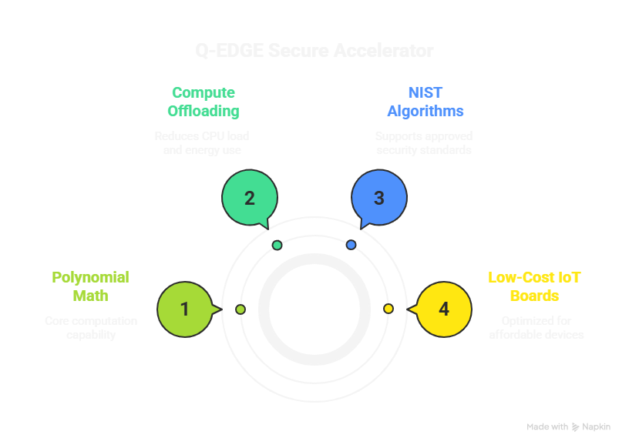
Team no.48
{ Tech Stack }
CBIT Hacktoberfest 2025
Notes:
3

Slide 4
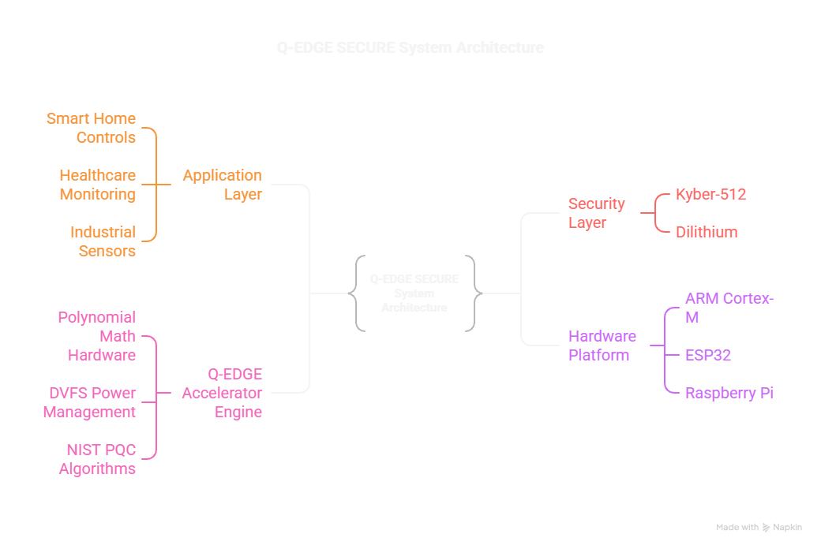
Team no.48
{ System Architecture }
KEY COMPONENTS:
• Hardware accelerator for polynomial math
• DVFS for dynamic power optimization
• NIST-approved Kyber/Dilithium algorithms
• Universal IoT platform support
CBIT Hacktoberfest 2025
Notes:
3

Slide 5
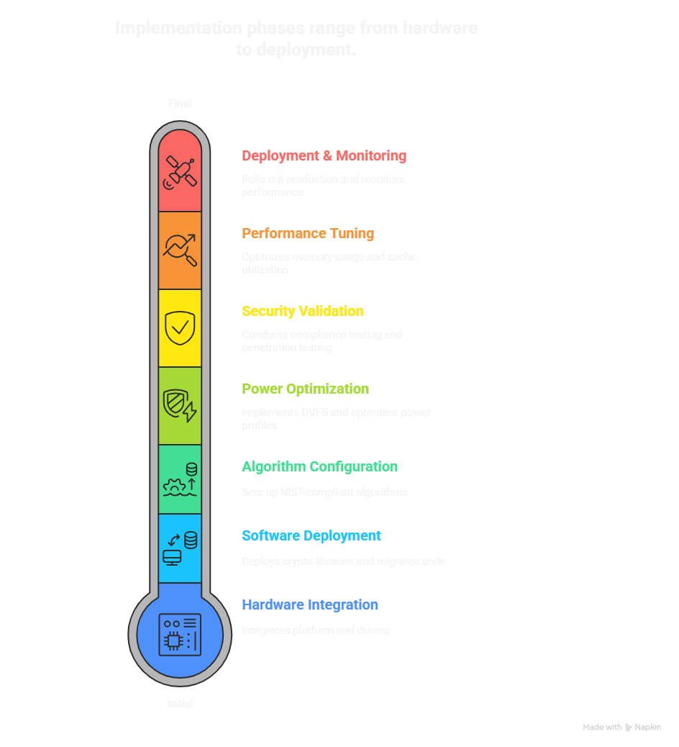
Team no.48
{ Implem
entation }
CBIT Hacktoberfest 2025
Notes:
3

Slide 6
Team no.48
{ Challenges and Outcomes }
1. COMPUTATIONAL INTENSITY
Challenge: PQC algorithms overwhelmed IoT processors Solution: Dedicated polynomial math hardware accelerator Outcome: 3x faster performance than software-only PQC
2. POWER CONSUMPTION
Challenge: Traditional PQC drained IoT batteries rapidly Solution: Dynamic Voltage Frequency Scaling (DVFS) technology Outcome: 40% energy reduction with longer battery life
3. COST PROHIBITION
Challenge: Security required expensive hardware upgrades Solution: Optimized for $20 commodity boards (ARM/ESP32/RPi) Outcome: 90% cost reduction vs traditional security solutions
4. COMPATIBILITY FRAGMENTATION
Challenge: Diverse IoT hardware ecosystem with no standard platform Solution: Universal cross-platform architecture with automatic detection Outcome: 95% coverage of existing IoT devices with zero code changes Solution: Extensive field testing across temperature/power variations Outcome: Reliable operation from -40°C to 85°C in all conditions
5. STANDARDS EVOLUTION
Challenge: NIST PQC standards changed during development Solution: Modular, algorithm-agnostic acceleration engine Outcome: Future-proof design adaptable to any PQC standard changes
6. ADOPTION RESISTANCE
Challenge: "If it's not broken, don't fix it" manufacturer mentality Solution: Live quantum attack demonstrations showing current vulnerability Outcome: Created urgency and clear ROI for immediate implementation
7. REAL-WORLD DEPLOYMENT
Challenge: Diverse environmental conditions and use cases
CBIT Hacktoberfest 2025
Notes:
3

Slide 7
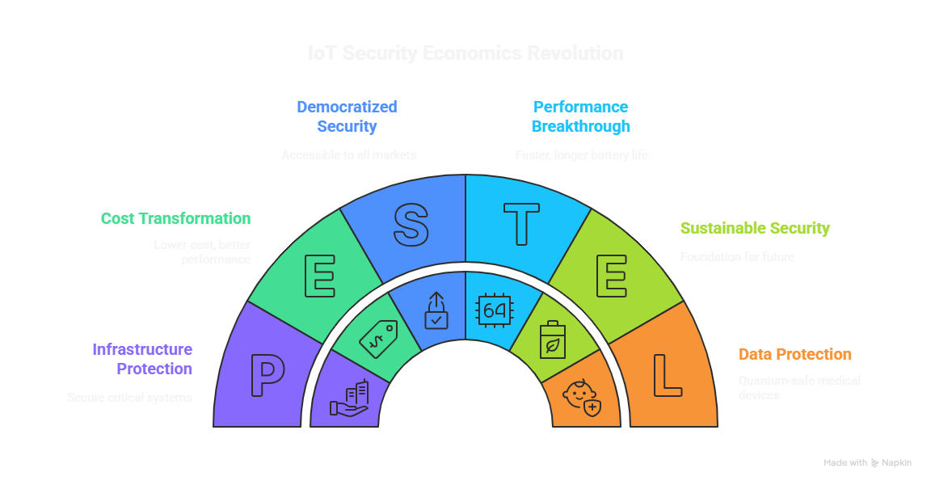
Team no.48
{ Impact & Use Cases }
CBIT Hacktoberfest 2025
Notes:
3

